Slide 1
Pie Plot using Matplotlib
Genesis Grant
CTEC 298

Slide 2
Pie Plot
Represent a certain point in time
Used to show proportions of categories(categorical data) within a whole
Easy to interpret and effective

Slide 3
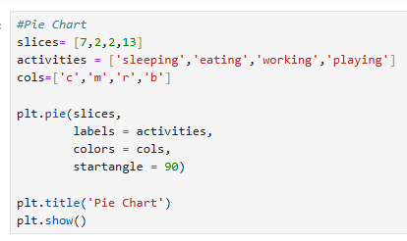
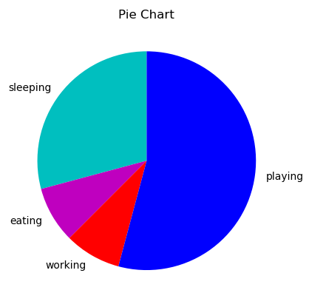
Basic Pie Chart Creation
Original Data: slices, activities, cols
Use plt.pie for creating pie plots
Slices = data values
Activities = labels
Cols = colors
Startangle = the angle at which the first slice will lay
Plt.title = establish title
Plt.show = display plot

Slide 4
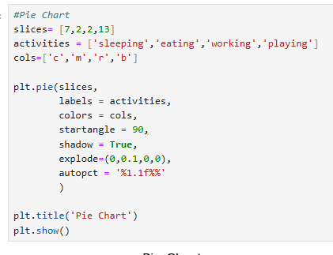
Extra Features
Shadow = include shadow in display or not
Explode = enlarge a certain slice
Autopct = display the percentages on the graph

Slide 5
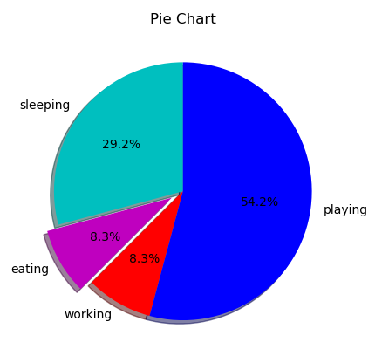
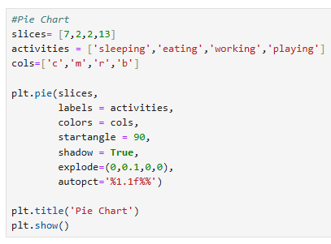
Final Code & Pie Plot

